Slide 1

Memory Skills Group
Week 4 : Internal Memory Strategies
Rebecca Niebieszczanski (Trainee Clinical Psychologist)
Kirsty Ellis (Assistant Psychologist)
Lesley Stewart (Consultant Clinical Neuropsychologist)
Revised 2019
Anja Steiner (Assistant Psychologist)
Callum Furniss (Trainee Clinical Psychologist)
Gill Cooke (Consultant Clinical Neuropsychologist)

Slide 2

Welcome!
Notes:
Welcome participants to the group
Explain that the group is for individuals who report difficulties with their memory
Important that we have realistic expectations that the group is not about ‘getting rid’ of our memory difficulties
The group will offer skills and information that will help us to manage these memory difficulties
2 hours with break

Slide 3




Housekeeping:

Slide 4

Group Rules
Confidentiality
Respect
Share thoughts, ideas and experiences
Time keeping
Mobile phones
Notes:
Confidentiality – please respect each others information. Please discuss your own thoughts and materials with others but protect the confidentiality of members of the group by keeping discussions to how you feel and your own situation. Limits
Respect each other and allow each other space to talk and share different opinions
Please talk slowly and thoughtfully speaking one at a time so that everyone can hear and follow what is being said
Time keeping – please arrive on time so that the group can start promptly
Please switch mobile phones to silent
Is there anything that you would suggest could help the group to run smoothly?

Slide 5
Overview of the course:
Session 1 Introductions and an overview of cognitive abilities
Session 2 Overview of memory
Session 3 External memory enhancement strategies
Session 4 Internal memory enhancement strategies
Session 5 Mood and cognitive functioning
Session 6 Keeping well, course reviews and goodbyes
Notes:
6x 2 hour sessions
The emphasis of this group is active participation and it is equally important to contribute as much as you feel you can.
It is also important that you attend all the sessions, however, if for some reason you can’t attend the group - let us know
Taught materials
Discussions
Exercises and chances to practice
Contact details in booklet if need additional support, talk to facilitators
Facilitators might make notes throughout to remember content of session

Slide 6

Session Outline
Welcome and grounding exercise
Summary of last session
Review of out of session work
Overview of internal memory strategies
An example of an internal memory strategy
Out of session work
Summary

Slide 7
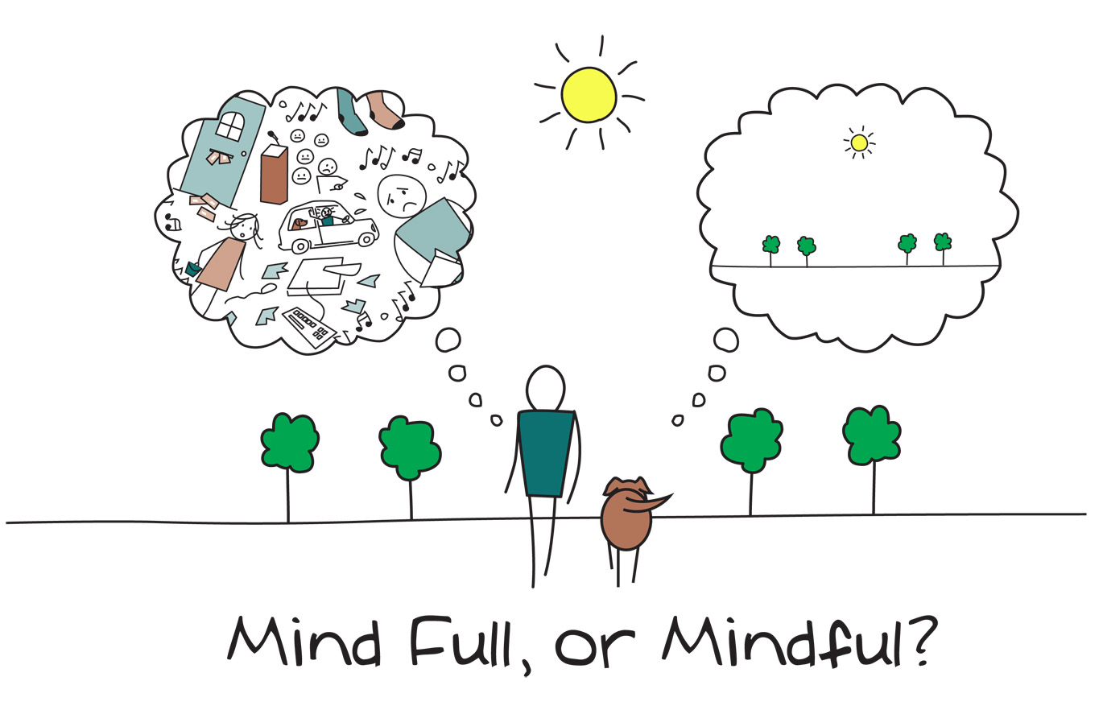
Mindfulness
Notes:
As we said in the last session, when you come into each session there may be lots of things on your mind. You might have thoughts about what you’ve been doing, what you need to do, maybe some expectations or perhaps worries about what the group itself will be like. Our minds often wander and life is sometimes filled with stresses or worries.
To start off today, and at the beginning of our future sessions, we will carry out a brief breathing exercise. The aim of this is just to help us be more present ‘in the moment’, and give us some time to become more aware of our thoughts, feelings and any physical sensations.
As we’ll see later in the course, this can also support our cognitive functioning and help our memory along with promoting overall well-being. If you have difficulty focusing on the breath (e.g. due to breathing difficulties) then go at a pace that feels comfortable to you, stop the meditation or focus on another part of your body, such as your feet.
Below are some of the core principles of mindfulness:
The ‘being’ mode: Mindfulness says that often we are so caught up in these thoughts about the past and future (the ‘doing’ mode) that we end up not paying attention to what’s happening around us now (the ‘being’ mode).
Self-compassion: We often have so much compassion and empathy for others that we forget to have the same for ourselves. Mindfulness is about extending some of this kindness to ourselves.
Mindfulness can have a positive impact on lots of areas of our lives including:
Emotional wellbeing: becoming more aware of our unhelpful thoughts and feelings and distancing ourselves from these. This can help us to realise that thoughts are just that thoughts! We will talk more about this in sessions 5 and 6.
Physical wellbeing: Becoming more aware of our bodies can be very useful for managing stress and reducing the release of cortisols. This is because we’re often not even aware of the impact of stress on our bodies. We will also discuss this in more detail in another session
Cognitive functioning: Mindfulness can be used to help improve our attention. By becoming aware of our thoughts, feelings and physical sensations we can bring our attention back to the present moment and reduce how much time we spend in automatic pilot. This can actually also help us to train our attention and help us to process and encode information effectively.

Slide 8
Last Session: Summary
Overview of external memory strategies
Communicating my difficulties to others – who to communicate them to and some of the benefits
Notes:
Home practice: how was it? Any particular difficulties? Anything from previous session? Any strategies noted down?

Slide 9
Reviewing Weekly Goals
Trying out a new memory strategy for the week:
Were you able to do it?
Was it difficult to do?
Was it helpful/unhelpful?
Notes:
Home practice: how was it? Any particular difficulties? Anything from previous session? Any strategies noted down?

Slide 10
Internal Strategies – what are they?
Internal memory enhancement strategies are strategies that we use within our minds to aid memory.

Slide 11
Internal Strategies – why use them?
Can help us to pay attention and process information by relying on our inner/internal resources.
They focus on different parts of the process of memory, including encoding, storage and retrieval and can be useful for remembering new information.
More difficult to use than external strategies and require practice!
Might be best used for remembering specific things e.g. names
There might be situations when external strategies aren’t available e.g. names

Slide 12
The Process of Memory
Attention
First you must focus on something; this includes listening and looking.
Information Processing
Then you have to process and understand that information.
Encoding
That information is then changed into a way that the brain can understand and store it.
Storage
Once encoded, the information is stored into your memory.
Retrieval
Once it has been stored, we must be able to pull the information back out; as and when we need it.
Notes:
The process of learning and remembering is quite complex and requires lots of different abilities and skills. This includes attention, information processing, encoding, storage and retrieval.
When we talk about memory or say my memory is bad, its easy to think of memory as one singular function. By being specific about what memory difficulties we notice and what aspects work better can help us to identify where in the process our main difficulties are. Therefore we’re able to come up with more effective and targeted strategies to support memory.

Slide 13
Mindfulness

Slide 14
Brain Exercise

Slide 15
Chunking of Information

Slide 16
Making associations
Notes:
+stories

Slide 17
Visual Imagery
Notes:
+retracing

Slide 18
Stories

Slide 19
Errorless Learning
Notes:
+cues and prompts

Slide 20
Repetition

Slide 21
Expanded Rehearsal

Slide 22
Question – 5ws + PQRST

Slide 23
Stage | Strategies
Attention | Mindfulness meditation Making associations Visual imagery
Information processing | Making associations Visual imagery
Encoding and storage | Chunking Grouping PQRST Repetition Expanding rehearsal Making associations Stories Visual imagery
Retrieval | Mindfulness meditation Mental retracing Making associations Visual imagery

Slide 25
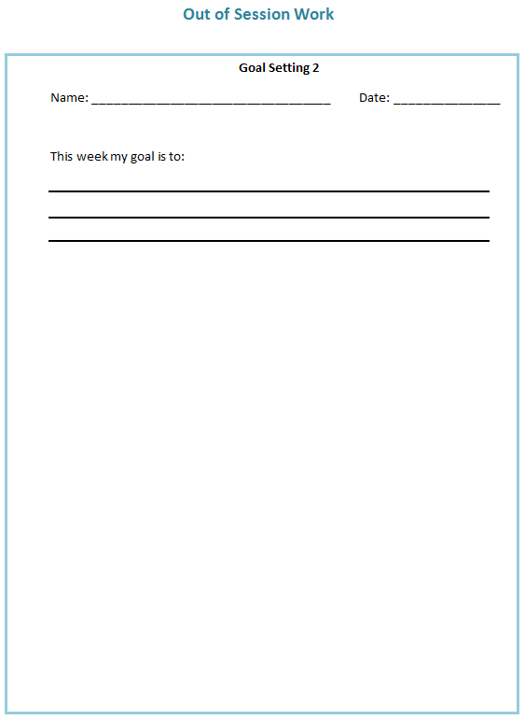
Out of Session Work
Weekly
SMART goals
Review in following session
Notes:
Helpful to think about own difficulties and to identify any strategies that are already providing to be useful, share them with the group

Slide 26

Summary
Introductions
Overview and aims of the course
Internal strategies – what are they? why use them?
Goal setting
Home practice

Slide 27
Thank you for attending
Anja Steiner, Assistant Psychologist
Callum Furniss, Trainee Clinical Psychologist
01782 275188
Notes:
Contact details if you are having difficulties with the programme. There will also be space to ask any questions and explore with us your difficulties within the group if you feel comfortable sharing these.

